Slide 1





DATA & ANALYTICS AT SCALE
CRM
Miguel Reis | CRM
CRM
CUSTOMER INTELLIGENCE
02/02/2021
CRM
RELATIONSHIP
MarketinG
& PERFORMANCE

Slide 2
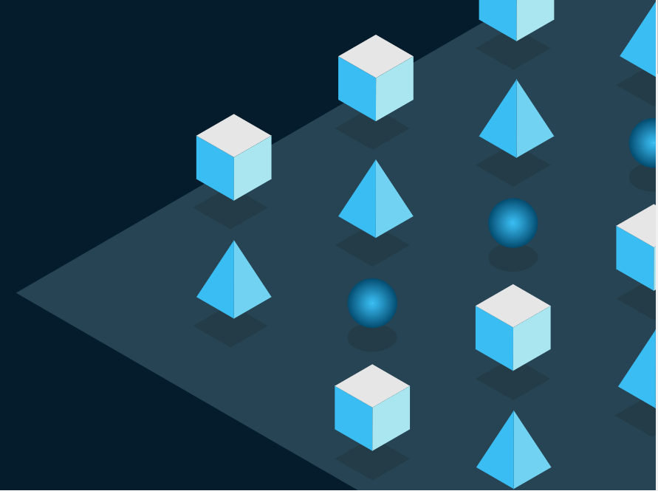

Executive Summary
Developing artificial intelligence and analytics applications typically involves different processes, technology, and talent than those for traditional software solutions.
We have to possess a solid understanding of the basics, in order to ensure that we’re making the right investments in the tech stacks and teams to build reliable solutions at scale.

Slide 3
Table of Contents
Defining environments
Data Lab
Data Factory
MLOps & Ways of working

Slide 4
Defining environments
1

Slide 5
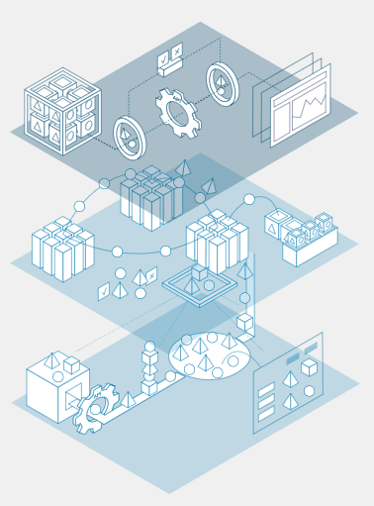
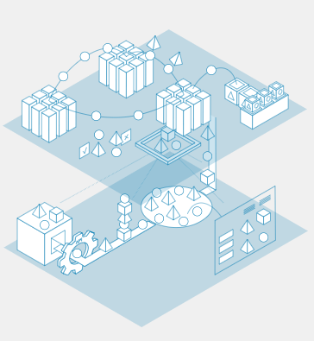
Defining environments
Analytics LAB
Due to its experimental nature, analytics development work, including data exploration, experimentation with predictive models, and development of prototypes through rapid iterations, must be performed in a “lab” environment that’s separate from other systems so that it doesn’t hinder normal business operations. Lab technologies must be flexible and scalable to handle changing demands of the analytical approach (eg, new data, new modeling techniques) and modular to enable developed solutions to port to the factory through DevOps.
Analytics FACTORY
After development in the lab, analytics models move into the “factory” which provides an environment for running analytics jobs 24 hours a day, 7 days a week, 52 weeks a year. In order to put a solution into production at scale (ie, making it regularly and reliably accessible to users), it has to be robust (able to handle typical errors, including variances in incoming real-world data), maintainable, executed efficiently through continuous deployment processes, and integrated with core systems, and it must include performance management and risk controls to avoid any detrimental impact on operations.

Slide 6
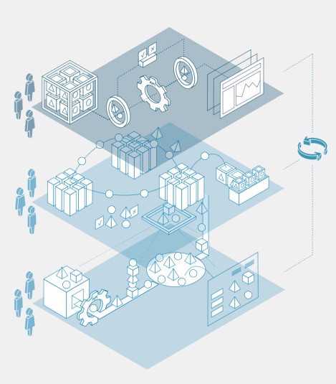
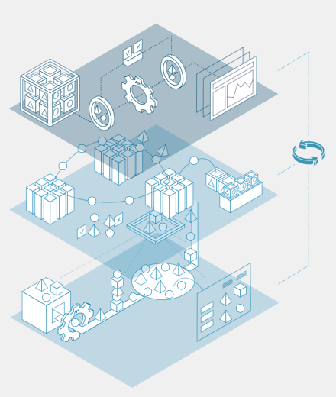
Ways of working
MLOps
MLOps refers to DevOps as applied to machine learning and AI.
Short for “software development” and “IT operations,” DevOps is the application of software engineering practices to IT operations, such as packaging and deploying production software.
MLOps aims to shorten the analytics development life cycle and increase model stability by automating repeatable steps in the workflows of software practitioners (including data engineers and data scientists). While MLOps practices vary significantly they typically involve automating integration (the frequent checking in and testing of code) and deployment (packaging code and using it in a production setting).
Roles
The work in the lab and factory is carried out by cross-functional teams made up of data and software professionals (eg data scientists, machine learning engineers, cloud architects) as well as business professionals with varying levels of data science expertise (eg, subject matter experts, translators).

Slide 7
DATA LAB
2

Slide 8
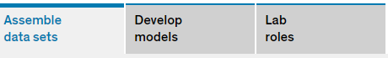
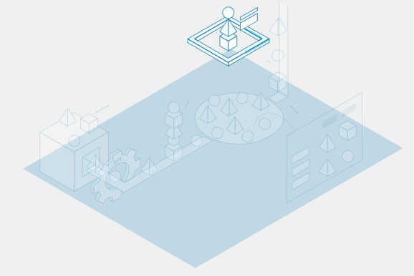
Assemble data sets
PROCESSES
TECHNOLOGIES
Data
ingestion
Source systems
Data
APIs
Batch
Data
pipeline
Data
lake
Data
catalog
Definition
The process of assembling, cleaning and combining data from various source systems to create data sets for analytics. Data sources can be both internal and external and data is often combined into a single cleaned data set for analytics model development.
Why it’s important
Ensuring that a wide range of data sets can be ingested quickly, easily and frequently is important for model development.
The quality of analytics models is dependent of both the quantity of data available and the variety of relevant datasets. Most labs start out with manual data extracts and rapidly automate the ingestion process so that it can occur regularly (eg, daily) in order to ensure data available for analytics model development are fresh.

Slide 9
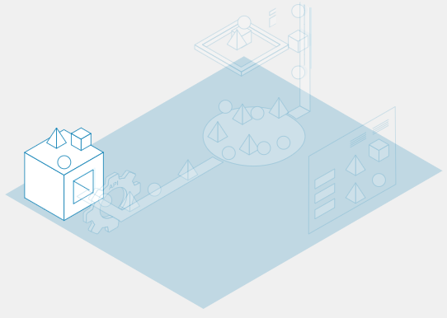
Assemble data sets
PROCESSES
TECHNOLOGIES
Data
ingestion
Source systems
Data
APIs
Batch
Data
pipeline
Data
lake
Data
catalog
Definition
Systems containing data (eg, ERP, CRM, transaction systems) that need to be extracted, cleaned, and consolidated for analytics purposes.
Why it’s important
A deep understanding of the source-data location, storage formats, and data structures is needed to develop data-extraction processes (eg, pipelines) to source and consolidate data for analytics.

Slide 10
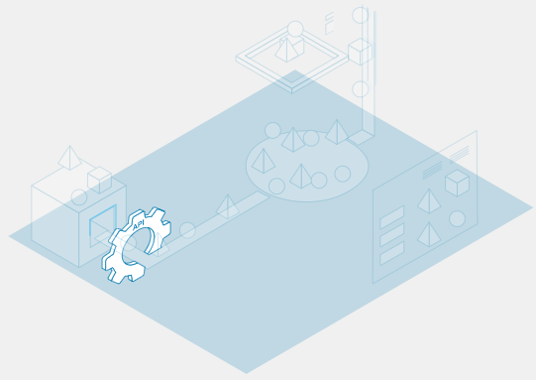
Assemble data sets
PROCESSES
TECHNOLOGIES
Data
ingestion
Source systems
Data
APIs
Batch
Data
pipeline
Data
lake
Data
catalog
Definition
An application programming interface (API) is a software intermediary that allows two applications to talk to each other (REST API, gRPC, and GraphQL are examples of APIs used to access data)
Why it’s important
APIs have become the de facto standard for integrating software components. In this case, they enable access to data in organizational and third-party systems.

Slide 11
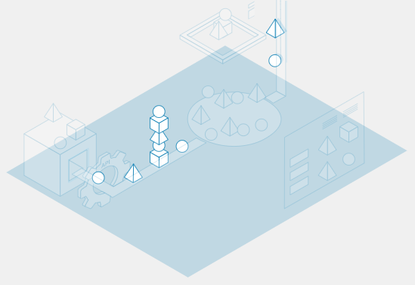
Assemble data sets
PROCESSES
TECHNOLOGIES
Data
ingestion
Source systems
Data
APIs
Batch
Data
pipeline
Data
lake
Data
catalog
Definition
Batches are extractions of larger amounts of data on a less frequent basis (eg, monthly batches of account openings).
Micro batches are extractions of small amounts of data, often frequently (eg, daily batches of hourly transactions).
Why it’s important
Batches allow for efficient processing of large amounts of data.
Batch or micro-batch data replication will depend on the type of data (eg, master vs transactional) and frequency of the data being updated (eg, daily sales).

Slide 12
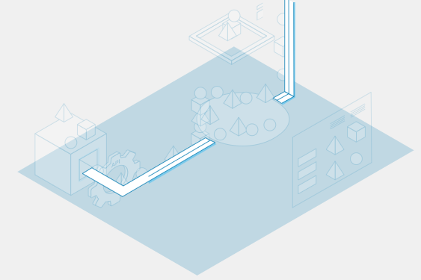
Assemble data sets
PROCESSES
TECHNOLOGIES
Data
ingestion
Source systems
Data
APIs
Batch
Data
pipeline
Data
lake
Data
catalog
Definition
Manages the sequence of ETL steps that automate the movement, transformation, and serving of data
It can be used to move data from source systems to the data lake, within the data lake, or from the data lake to other systems.
Why it’s important
Data pipelines manage the sequencing (or “orchestration”) of the different data collection/transformation steps. Automating data pipelines ensures data can be moved in a timely and reliable manner.

Slide 13
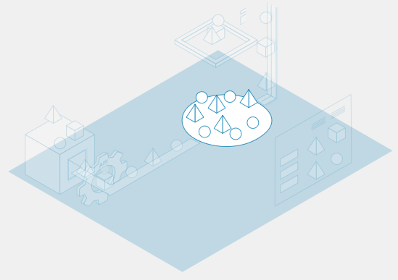
Assemble data sets
PROCESSES
TECHNOLOGIES
Data
ingestion
Source systems
Data
APIs
Batch
Data
pipeline
Data
lake
Data
catalog
Definition
Single centralized storage of all enterprise data in raw format
Data are stored as is, without transformation, so they can be transformed after being loaded (ie, moved using ETL).
Why it’s important
Data lakes enable enterprises to pool data from different sources and allow analytics teams to generate data sets for analytics by combining raw data in different formats from a variety of sources.
Because data lakes have effectively infinite storage capacity, enterprises can store all the data they generate, even if they’re not immediately applicable to analytics use cases.

Slide 14
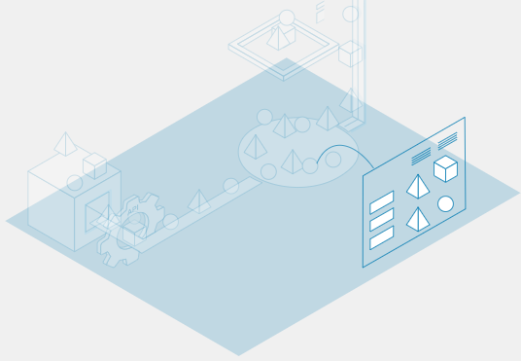
Assemble data sets
PROCESSES
TECHNOLOGIES
Data
ingestion
Source systems
Data
APIs
Batch
Data
pipeline
Data
lake
Data
catalog
Definition
Tool to store metadata that enables easy searching through a directory to find what data elements exist across the enterprise, how they are linked, and what the characteristics of the data are (eg, date formats).
Why it’s important
Data catalogs provide a valuable source of information about the data for data scientists, data engineers, and business analysts.

Slide 15

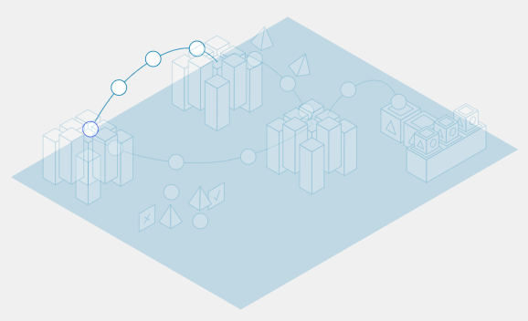
Develop models
PROCESSES
TECHNOLOGIES
Build
Train
Test
Deploy
Processing unit
Cluster
Definition
Stage of analytics development during which data scientists choose a few algorithms and techniques that might be best suited for the task at hand (eg, regression, classification, reinforcement learning) to test so they can build models based on the type of problem (eg, prediction or optimization) and the type of data available
The initial user interface is also created at this stage.
Why it’s important
Modelling approaches must match the problem being solved as well as the required level of transparency of model outputs (eg, simpler techniques make it easier to understand why the model makes certain predictions).

Slide 16
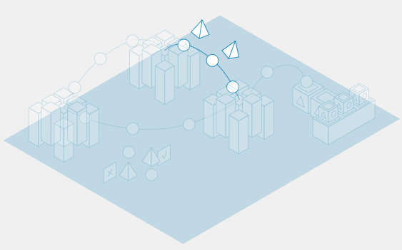
Develop models
PROCESSES
TECHNOLOGIES
Build
Train
Test
Deploy
Processing unit
Cluster
Definition
Providing an algorithmic model with data so it can learn from the data to perform its task (eg, prediction)
Typically, data scientists train models using software frameworks and libraries (eg, scikit-learn, PyTorch) that make it easy to leverage high-performing algorithms in a standardized way.
Why it’s important
A trained machine learning model is required to provide predictions.

Slide 17
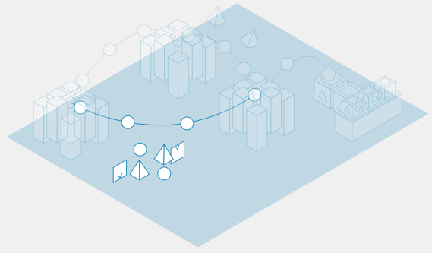
Develop models
PROCESSES
TECHNOLOGIES
Build
Train
Test
Deploy
Processing unit
Cluster
Definition
Evaluating performance of the trained model by comparing the predictions the model generates from new data to known values
Training data is usually divided into a ratio of 60:20:20: independent training on 60 percent of the data, validation on 20 percent of the data, and 20 percent on testing data sets.
For the different model options that are trained and tested, validation measures performance on unseen data.
Why it’s important
Testing helps data scientists understand how accurately the model will perform in the real world. It allows them to tune the model to improve its performance.
The performance on unseen data is a measure of “generalizability” of how well the model is likely to perform once released and used in a live production setting.

Slide 18
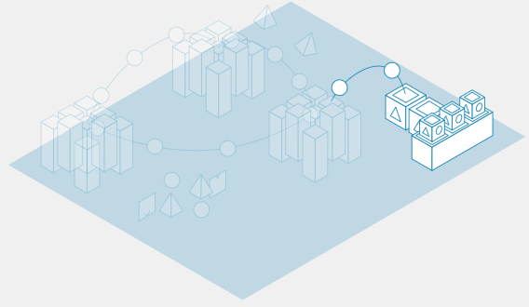
Develop models
PROCESSES
TECHNOLOGIES
Build
Train
Test
Deploy
Processing unit
Cluster
Definition
Promoting the trained model into a production environment
The model is typically “packaged” into a unit of software that can be deployed and easily used to generate predictions in a repeatable manner (AWS SageMaker, Azure Machine Learning services, Kedro-Server are examples of deployment tools).
Why it’s important
Stable, repeatable deployment mechanisms enable businesses to update models with lower lead times after training models on new data sets.

Slide 19
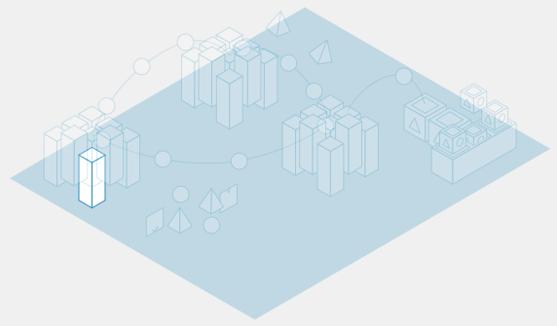
Develop models
PROCESSES
TECHNOLOGIES
Build
Train
Test
Deploy
Processing unit
Cluster
Definition
Performs computations, processes data, and trains machine learning models
Processing units come in three major types: central processing units (CPUs), graphic processing units (GPUs), or custom hardware:
CPU: Most common and commoditized general-purpose processor
GPU: Initially built for graphics display cards, it has been used extensively in the past decade by machine learning algorithms for its ability to parallelize and reduce computation time
Why it’s important
The type of processing unit can impact model training and performance.
GPUs are more expensive but provide better performance (faster to train and predict) than CPUs.
Custom hardware (eg, TPUs) can offer superior performance to CPUs and GPUs but are typically relevant only for research or companies at the leading edge of AI development.

Slide 20
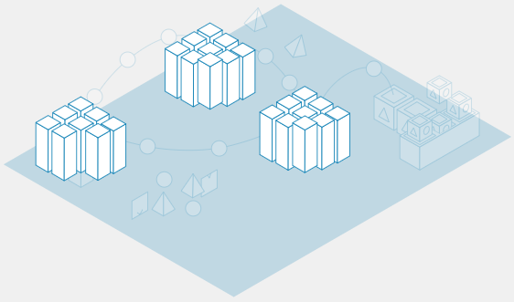
Develop models
PROCESSES
TECHNOLOGIES
Build
Train
Test
Deploy
Processing unit
Cluster
Definition
Collection of computing processing resources used to train analytics models, which can be autoscaled to fit computing demands.
Why it’s important
Clusters are deployed to leverage multiple machines simultaneously and have them work in parallel, reducing the total time to complete a calculation.
Data scientists (or machine learning engineers) will usually have to make a trade-off between the modelling technique they use and its ability to be distributed or parallelized. Clusters can be used only when the workload can be distributed (ie, parallelizable).

Slide 21


Lab roles
Product owner
Data
scientist
Data
engineer
Translator
Designer
Delivery manager
Responsibilities
Typically a business owner who takes on part-time or full-time responsibility as the product owner
Provides the “voice of the customer” to define success criteria for the squad
Serves as the first point of contact with any external stakeholders
Reviews and prioritizes the short- and mid-term objectives
Brings users into the development process (eg, for feedback) as needed

Slide 22

Lab roles
Product owner
Data scientist
Data engineer
Translator
Designer
Delivery manager
Responsibilities
Frames the business problem and identifies analytics techniques to address it
Collaborates closely with the engineering team to prioritize data transformations for training data and features for prediction
Programs advanced analytics algorithms
Develops visuals to illustrate model mechanisms and performance

Slide 23

Lab roles
Product owner
Data scientist
Data engineer
Translator
Designer
Delivery manager
Responsibilities
Scopes data available and identifies major source systems to consolidate data for analytics
Develops data pipelines that simplify and automate data movement
Sets up data architecture (data storage, data layers)
Collaborates with data scientists to transform data (eg, create new data features for prediction) based on model requirements

Slide 24

Lab roles
Product owner
Data scientist
Data engineer
Translator
Designer
Delivery manager
Responsibilities
Acts as the interface between business and technical stakeholders
Helps the product owner to make trade-offs between business requirements and technical complexity
Prepares materials to support integration activities, such as process maps and change-management stories

Slide 25

Lab roles
Product owner
Data scientist
Data engineer
Translator
Designer
Delivery manager
Responsibilities
Focuses on the interaction between end users and the analytics solution output
Develops dashboard concepts and the user-interface controls that will ensure users can consume the analytics output

Slide 26

Lab roles
Product owner
Data scientist
Data engineer
Translator
Designer
Delivery manager
Responsibilities
Responsible for all aspects of delivery of the analytics solution (eg, secures licenses, handles solution access requests) to meet the lab team’s goal
Can play the role of scrum master (facilitator of the agile-development process)
In complex settings, the delivery-manager and scrum-master role can be split into two

Slide 27
DATA FACTORY
3

Slide 28

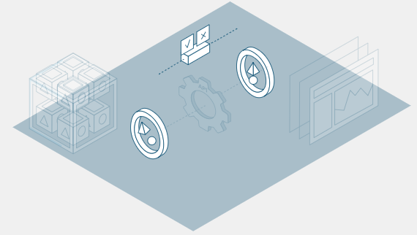
Run analytics
PROCESSES
TECHNOLOGIES
Monitoring
Container
Kubernetes
Microservice
API
Consumption layer
Definition
The process of checking a model’s predictions—as well as the data flowing into it—while it is in use to ensure it is performing as expected
Why it’s important
Model performance can “drift” over time, whereby the predictions become less accurate due to some real world complexity not captured in the model. Data scientists also monitor for unexpected bias or fairness issues that the model could exhibit. They can tweak the model architecture or provide new training or new data sources to correct these issues.

Slide 29

Run analytics
PROCESSES
TECHNOLOGIES
Monitoring
Container
Kubernetes
Microservice
API
Consumption layer
Definition
Standard unit of software-code packaging and all its dependencies
Containers (eg, Docker, rkt) are used to package and deploy production applications (eg, a completed model that is ready to perform daily predictions as part of a business process).
Why it’s important
Containers enable a “build once, run anywhere” approach. Similar to shipping containers that are able to be used regardless of shipping mode (ship, train, truck), containers allow code to be packaged in a standardized format to run on different kinds of underlying operating systems and hardware (eg on cloud or on-premises).

Slide 30
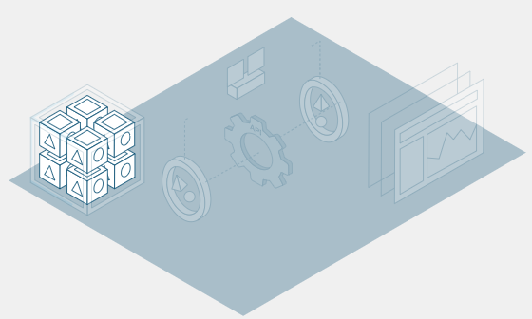
Run analytics
PROCESSES
TECHNOLOGIES
Monitoring
Container
Kubernetes
Microservice
API
Consumption layer
Definition
Open-source system that automates deployment, scaling, and management of containers.
Why it’s important
As the number of models in a company increases, managing a high number of containers can be challenging. Kubernetes is designed to simplify this challenge.
Kubernetes is often seen as a “vendor-neutral” deployment platform for containers.

Slide 31
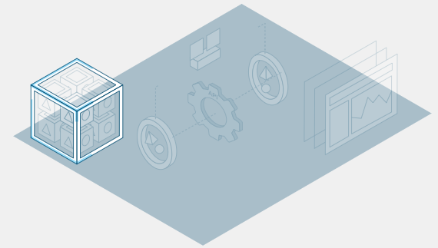
Run analytics
PROCESSES
TECHNOLOGIES
Monitoring
Container
Kubernetes
Microservice
API
Consumption layer
Definition
A software architecture style to develop and maintain code as independently deployable services, which are often run in containers
Rather than building large software “monoliths” that are tightly integrated, microservices are small and independent software components that integrate with other components using APIs.
Why it’s important
Microservices allow reusability. Code can be invoked by other applications or microservices. Microservices are loosely coupled, allowing teams to remain relatively independent and avoid complex dependencies between software.
Microservices also enable developers to write code in the language that is most convenient to them. As long as the external interface (API) remains consistent, changes can be made to the underlying software as needed.

Slide 32
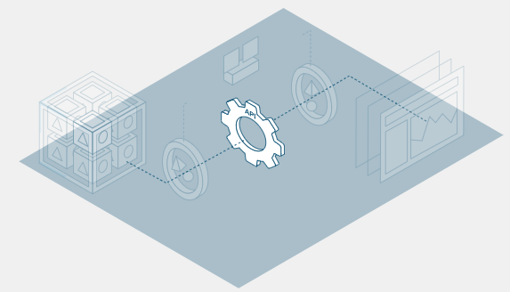
Run analytics
PROCESSES
TECHNOLOGIES
Monitoring
Container
Kubernetes
Microservice
API
Consumption layer
Definition
An application programming interface (API) is a software intermediary that allows two applications to talk to each other (REST API, gRPC, and GraphQL are examples of APIs used to access data).
Why it’s important
An API can be accessed by many applications, enabling reusability of code. In this case, for example, many analytics applications can access prediction results from a single model through an API.
An API also allows technical teams to make “under the hood” changes to analytics without impacting users (eg, the model can change as long as results are provided in the same format).

Slide 33
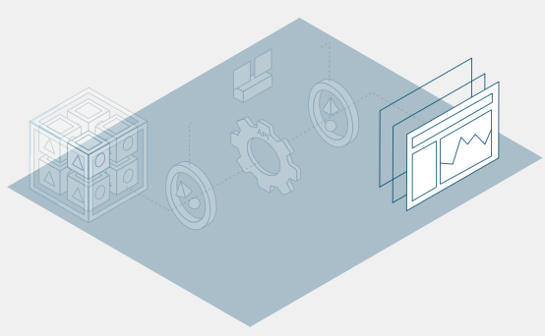
Run analytics
PROCESSES
TECHNOLOGIES
Monitoring
Container
Kubernetes
Microservice
API
Consumption layer
Definition
Consists of interfaces that are used to expose the results of models to analytics consumers (either users or other applications), API services that serve or push information to other systems, and process interfaces that trigger business processes.
Why it’s important
Interfaces are important to enable consumers to act upon the data and predictions generated by the underlying model.

Slide 34


Factory roles
Product owner
ML engineer
DevOps
engineer
Infrastructure architect
Full-stack developer
Others
Responsibilities
Serves as the first point of contact with external stakeholders
Defines solution success criteria
Reviews and prioritizes the short- and mid-term objectives
Participates in major team activities such as reviews and retrospectives
Manages budget and resources

Slide 35

Factory roles
Product owner
ML engineer
DevOps engineer
Infrastructure architect
Full-stack developer
Others
Responsibilities
Optimizes machine learning models for performance and scalability and deploys them into production to ensure repeatable and dependable operation
Automates the machine learning pipeline, from data ingestion to prediction generation

Slide 36

Factory roles
Product owner
ML engineer
DevOps engineer
Infrastructure architect
Full-stack developer
Others
Responsibilities
Develops continuous-integration (CI) and continuous-deployment (CD) pipelines to automate parts of the software-deployment pipeline
Increasingly known as MLOps engineer when specializing in machine learning

Slide 37

Factory roles
Product owner
ML engineer
DevOps engineer
Infrastructure architect
Full-stack developer
Others
Responsibilities
Designs new infrastructure components for analytics in accordance with enterprise guidelines (eg, data lake, streaming platforms)
Makes necessary technology-platform decisions and advises the teams on what platforms to leverage
Provides advice on integration patterns with various enterprise-data sources

Slide 38

Factory roles
Product owner
ML engineer
DevOps engineer
Infrastructure architect
Full-stack developer
Others
Responsibilities
Develops software components for the backend (eg, integrations) and front end (eg, web interfaces, microservices) of AI solutions
Multiple full-stack developers may be needed depending on the complexity of the solution (eg, a dashboard to visualize AI model results versus building an AI-embedded digital tool)

Slide 39
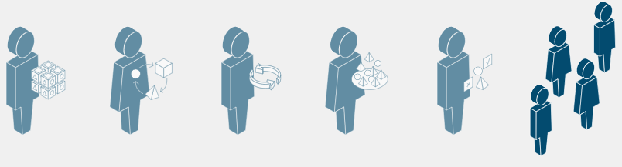
Factory roles
Product owner
ML engineer
DevOps engineer
Infrastructure architect
Full-stack developer
Others
Responsibilities
Software engineers
Cloud engineers
Cloud architects
Quality assurance and testing automation experts
Subject-matter experts

Slide 40
MLOps & WAYS OF WORKING
4

Slide 41

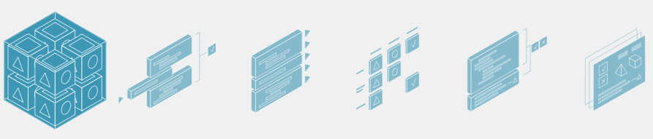
MLOps & Ways of working
Hardening
Continuous integration
Continuous delivery
Issue tracking
Logging
Monitoring
Definition
A collection of techniques and configurations used to make the software more robust, reducing vulnerabilities to security issues and errors that could happen in production and ensuring that the analytics solution’s results cannot be manipulated.
Why it’s important
As models are released into production and put to use, the inputs cannot be predicted and, in some cases, may be subjected to users or programs with malicious intent. Hardening reduces the potential negative impact by reducing the “surface area” that could be subject to attack. For example, hardening may ensure that all requests and responses to and from an API are encrypted even within an internal network.

Slide 42
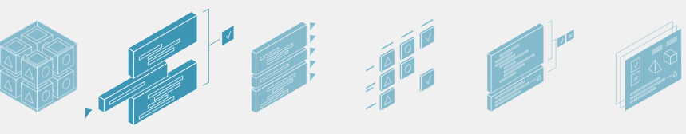
MLOps & Ways of working
Hardening
Continuous integration
Continuous delivery
Issue tracking
Logging
Monitoring
Definition
The process supporting code collaboration. When developers share back the code with the team, testing steps take place to ensure the “build” is not broken.
Continuous integration automates the process by which team members share back their working copies of code enabling it to occur frequently (multiple people sharing multiple times per day).
Mature teams leverage test automation and an “integration pipeline” to enable continuous integration.
Why it’s important
Automating integration can speed up developer productivity and help to rapidly identify issues.

Slide 43
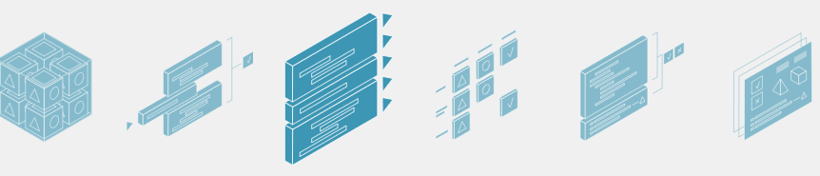
MLOps & Ways of working
Hardening
Continuous integration
Continuous delivery
Issue tracking
Logging
Monitoring
Definition
The process in which every time a software “build” passes the automated tests, it is deployable and can be released to production at any time
Environments are usually staged, going first through a development environment, then a user-acceptance environment, and then the production environment.
Mature teams have “deployment pipelines” that automate delivery.
Why it’s important
Continuous delivery aims to build, test, and release software with greater speed and frequency. This reduces deployment risk, since the changes between each version are small.

Slide 44
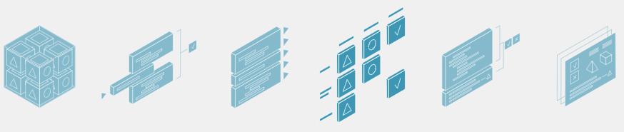
MLOps & Ways of working
Hardening
Continuous integration
Continuous delivery
Issue tracking
Logging
Monitoring
Definition
Software (eg, Jira) used to plan work for software developers, particularly for teams working in an agile manner.
Why it’s important
Planning software-development tasks can be complex and requires collaboration.
Work is broken down from user stories to features to tasks/issues that are implemented by software developers.

Slide 45
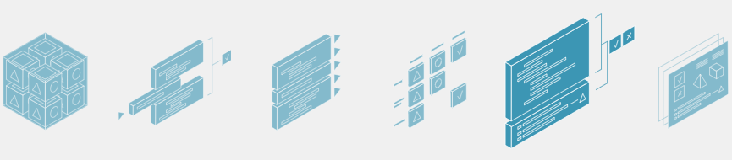
MLOps & Ways of working
Hardening
Continuous integration
Continuous delivery
Issue tracking
Logging
Monitoring
Definition
The creation of a detailed record of events that occurred within an application during its operation, which are typically stored in log files.
Why it’s important
Logging allows teams to troubleshoot issues by reviewing changes that happened to applications and systems via their respective logs.

Slide 46
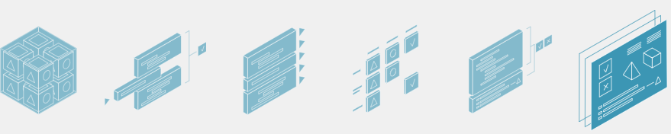
MLOps & Ways of working
Hardening
Continuous integration
Continuous delivery
Issue tracking
Logging
Monitoring
Definition
The observation and management of software components to ensure they are available and performing normally (as opposed to the monitoring of the model’s predictions that takes place while the model is in use).
Why it’s important
For jobs that need to run at particular times or services/applications that need to be available, application monitoring is crucial to ensure that software is performing as intended.
This is particularly important in production, when a model is no longer an experiment and is adopted by business users as part of normal business operations.

Slide 47


DATA & ANALYTICS AT SCALE
Thank You!
CRM

